Slide 1
Lecture 4

Slide 3
Leg movements at the same frequency as the swing’s natural frequency make the swing go higher

Slide 4
Driving Force
Last section we added a force that killed our oscillation
Suppose we want to keep it going
Add a force
where F_{o} is a constant and where ω_{f} is the angular frequency of the driving force
This one is very hard to solve

Slide 5
Steady State
Let’s assume that we add in enough energy with the driving force that we make up for the energy lost in the damping force
Then the solution is
EXCEPT
We will drop the subscript f for convenience

Slide 6
Example
Notice that right at ω_{o} our solution gets very big

Slide 7
Resonance
To see why resonance happens, think of the velocity
And our driving force is
The rate at which work is done (power) is
if F and v are in phase, the power will be at a maximum!

Slide 8
Example
Resistive force is never really zero in real systems
It can be small
Small b
Large b

Slide 9
Remember Tacoma Narrows?
The wind gusts formed a periodic driving force that allowed a driving harmonic oscillation to form.
Since the bridge was resonant with the gust frequency, the amplitude grew until the bridge materials broke.

Slide 10
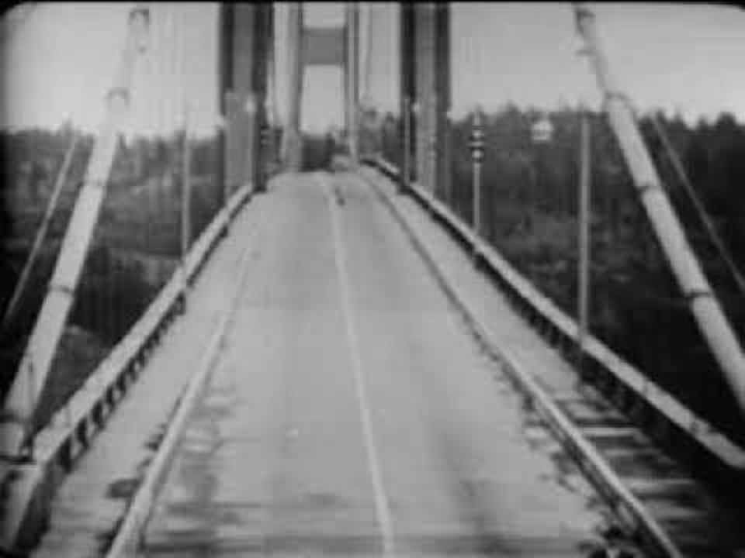
Remember Tacoma Narrows?
The wind gusts formed a periodic driving force that allowed a driving harmonic oscillation to form.
Since the bridge was resonant with the gust frequency, the amplitude grew until the bridge materials broke.

Slide 11
Summary
SHM along a straight line can be thought of as a projection of a uniform circular motion along a diameter of a reference circle
Pendulum
Physical Pendulum
Torsoinal Pendulum
Damped Oscillation
Forced Oscillation

Slide 12
Waves!

Slide 13
Question 223.2.1
For a wave to exist, you need the following
Source of disturbance, a medium, and a connection between medium elements
A fluid, an energy source, and distance
A liquid, a disturbance, and a transfer of energy
A really good touchdown that gets the crowd excited

Slide 14
Question 223.2.2
What is the medium for an ocean wave?…
The electromagnetic field
Air molecules
Free space
Water molecules

Slide 15
Question 223.2.3
Is an ocean wave …
Transverse
Longitudinal
A combination of transverse and longitudinal

Slide 16
Question 223.2.4
At a football game, “the wave” might circulate through the stands and move around the stadium. In this wave motion, people stand up and sit down as the wave passes. What type of wave would this be characterized as?
polarized wave
a) longitudinal wave
b) lateral wave
c) transverse wave
d) soliton wave
e) Cougar wave

Slide 17
Transverse Wave
Longitudinal Wave

Slide 18
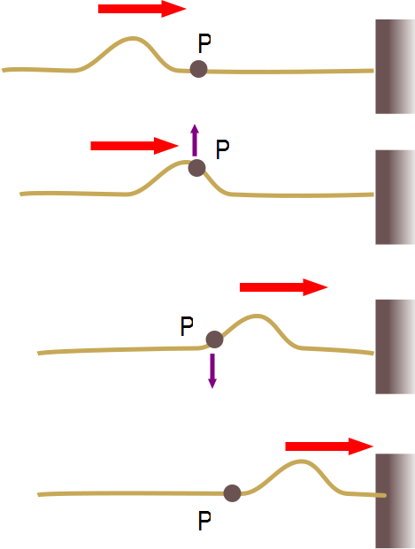

Slide 19
Question 223.2.5
In an ocean wave, what would be the most likely path a single particle traverses as the wave moves by?
B
A
C

Slide 20
Question
Suppose I have a uniform metal rod that has a length of 2.0m and a mass of 200.0kg. If I saw off 0.20m of this rod, how much mass would the piece have?
20kg
40kg
100kg
0kg

Slide 21
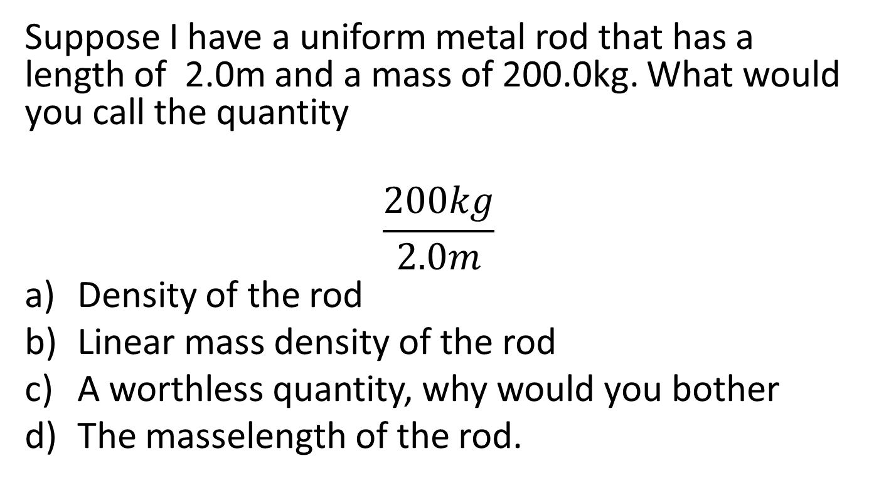
Question
Suppose I have a uniform metal rod that has a length of 2.0m and a mass of 200.0kg. What would you call the quantity
$$\frac{200kg}{2.0m}$$
Density of the rod
Linear mass density of the rod
A worthless quantity, why would you bother
The masselength of the rod.

Slide 22
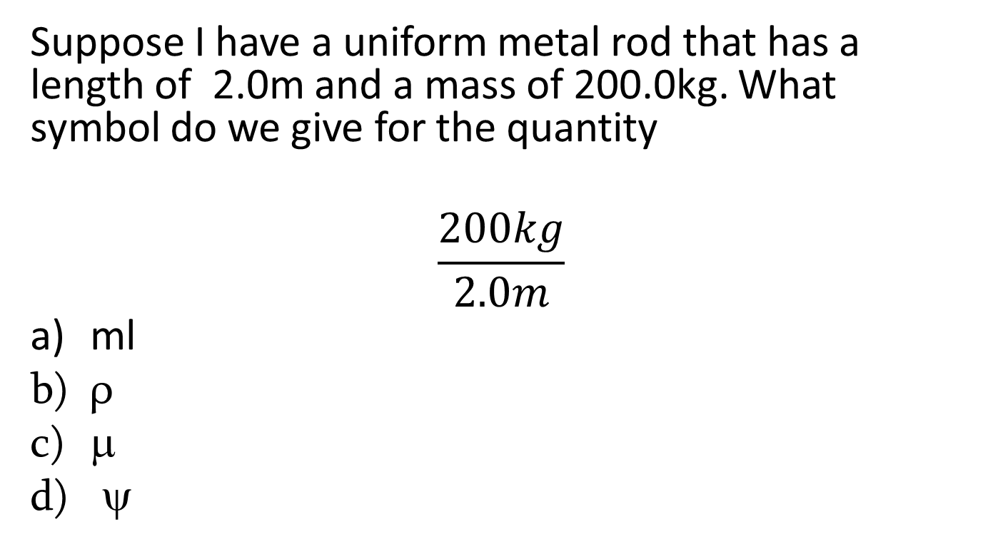
Question
Suppose I have a uniform metal rod that has a length of 2.0m and a mass of 200.0kg. What symbol do we give for the quantity
$$\frac{200kg}{2.0m}$$
ml
ρ
μ
ψ

Slide 23
Question 223.2.6
We learned that the speed of waves on strings is given by
Will this equation work for a wave traveling along a large vertically hanging chain?
Yes, this is a general formula
No, because chains are not strings
No, because the tension along the chain varies
No, because tension is unique to ropes and strings, and really chains experience normal forces between the links.

Slide 24
Question 223.2.7
Does a wave on a string move faster for a heavier or lighter rope?
Heavier
lighter

Slide 25
Question 223.2.7.5
A wave is traveling on a rope. Does the wave speed increase or decrease as you pull harder on a rope
Increase
Decrease

Slide 26
Question 223.2.9
We found that the equation
Gave a pulse that moved to the right with velocity v
What will the following equation give
A pulse that moves to the right (it is the same equation)
A pulse that moves to the left
This gives a non-real result and is not a pulse
A pulse that moves in the +y direction

Slide 30
Question 223.2.10
y
A
A traveling wave is shown below moving to the right at 1m/s in a snapshot view. What might the history graph look like for the position x=0?
time
y
B
time
y
C
x
time

Slide 31
y
t₁
x₁
x
y
t₂
y
x₁
x
y
x₁
t₃
t₁
t₂
t₃
t₄
time
x₁
x
y
t₄
x₁
x

Slide 34
End

Slide 36
Before
9
After
9

Slide 38
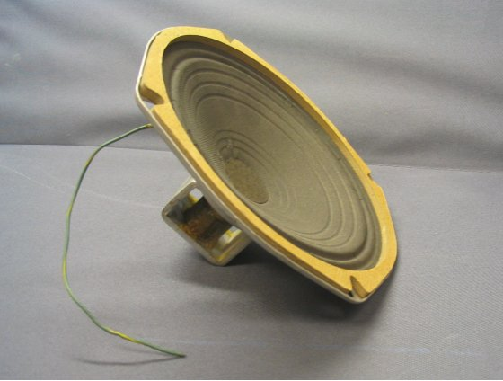

Slide 40
Question 7.5
For sound waves in air, something experiences simple harmonic motion, what is it?
A pipe
The air particles
The pressure
dust

Slide 41
Bar Graph of Displacement from Original Position

Slide 45
Question 223.2.8.1
S
x
In the displacement graph for a sound wave shown above. What does the light green bar represent?
The particle that was at this position has moved to the left
The particle that was at this position has moved to the right
The particle that was once where the pink bar is has moved to where the light green bar is
The particle that was once where the blue bar is has moved to where the light green bar is

Slide 46
Question 223.2.8.2
S
x₁
x_{P}
x₂
x
P
In the displacement graph for a sound wave shown above. What does the displacement, s, at point P represent?
The particle that was at x_{P} has moved to the left
The particle that was at x_{P} has moved to the right
The particle that was once at x₁ has moved to x_{P}
The particle that was once at x₂ has moved to x_{P}

Slide 47
Question 233.2.8.5
What is the energy transfer mechanism for sound waves?
Elastic forces between molecules
Pressure forces between molecules
Electrical forces between molecules
Collisions between molecules

